Slide 1

Revisiting Business Theory and Intellectual Capital in the Digital Era
A review of Peter Drucker's "Theory of Business" and its integration with intellectual capital concepts in today's knowledge economy, written by Ioannis Mantzakos, Phivos Mylonas, Christos Troussas, Akrivi Krouska, and Cleo Sgouropoulou .
Presentation by Ioannis Mantzakos
Notes:
"Good afternoon, everyone. My name is Yiannis Mantzakos, and on behalf of my co-writters and professors from the University of West Attica, it's an honor to be here today.
Our presentation is titled "Revisiting Business Theory and Intellectual Capital in the Digital Era".
Over the next 15 minutes, we will examine how essential both of these frameworks are to support organizations in flourishing within today’s knowledge-based economy".

Slide 2
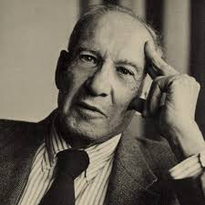
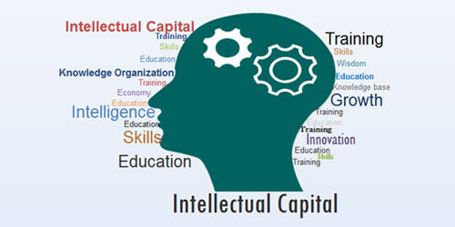
Introduction
This presentation examines the theoretical framework in Peter Drucker's "The Theory of Business" alongside the concept of intellectual capital.
We'll explore how foundational business assumptions align with the three components of intellectual capital:
Human capital
Structural capital
Relational/Customer capital
Understanding how knowledge assets and strategic assumptions drive innovation and sustainable business success in the digital economy.
Notes:
"As said at the start, we will be examining two key concepts.
On one hand, we have Peter Drucker's timeless "Theory of the Business", and on the other, the modern framework of intellectual capital.
Our goal is to explore how the foundational assumptions of a business align and integrate with the three key components of intellectual capital: human, structural, and relational capital.
Ultimately, we want to understand how knowledge assets and strategic assumptions drive innovation and sustainable business success in the digital economy."

Slide 3
Drucker's Theory of Business: Fundamental Assumptions
Environment
Mission
Core Competencies
Society, market, customers, and technology that surround the organization and influence its operations.
The organization's purpose, goals, and reason for existence that guide strategic decisions.
What the organization does best compared to others, creating competitive advantage.
Drucker argues that for sustained success, organizations must clearly define and understand these three core assumptions as a framework for strategic planning and decision-making.
Notes:
"Let's start with Drucker. He argued that every organization operates based on a set of core assumptions. These assumptions cover three critical areas:
First, the Environment: this includes the society, the market, and the technology within which the organization operates.
Second, the Mission: this is the organization's purpose, its very reason for existence.
And third, its Core Competencies: What the organization does best compared to others.
Drucker's main point was that for a business to succeed long-term, these assumptions must be clear, understood by everyone, and, most importantly, they must match reality."

Slide 4

Environment: Understanding External Context
The environment encompasses society, market structure, customer needs, and technology trends.
Organizations must understand how society works and how it relates to their management, finding thoughtful solutions when needed.
Nokia's transition from paper and rubber to telecommunications—and subsequent decline in smartphones—illustrates the importance of aligning with societal and technological shifts.
Every organization interacts with its people, operations, and the world around it, leading to various outcomes.
Notes:
"Diving deeper into the first assumption—the Environment.
It's about the external context, that is the shift that can happen on: society, market trends, customer needs, and technology.
A classic, powerful example of this is Nokia. In the late 20th century, Nokia perfectly understood the societal change towards mobile communication thus becoming a global leader. However, a decade later, they failed to correctly read the new environment. The rise of touchscreen interfaces and app ecosystems, led to their dramatic decline."

Slide 5
Mission & Core Competencies
Mission
Core Competencies
The goals an organization has, their importance, and how to achieve them.
What an organization does best compared to others, creating competitive advantage.
Directs employee efforts
Internal capabilities that differentiate
Explains organizational purpose
Foundation for sustainable advantage
Establishes performance standards
Key to stronger, more competitive business
Motivates behavior
Example: Apple's design philosophy, hardware/software integration, and ecosystem control have become hallmarks of its edge.
Example: Google's mission "to organize the world's information and make it universally accessible and useful" guides product development and unifies employees.
Notes:
"Let's move to the other two assumptions. First, the Mission. A well-defined mission is like a compass.
It directs employees, establishes performance standards, and motivates behavior.
Think of Google's mission "to organize the world's information". This clear and ambitious goal lead every strategic decision they've made, from Search to Maps, creating a purpose-driven culture.
Then, we have the Core Competencies. This is about identifying and taking advantage of the internal capabilities that truly set you apart.
For Apple, this is not just about making electronics; it’s about their deep expertise in innovative design, hardware/software integration, and ecosystem control."

Slide 6
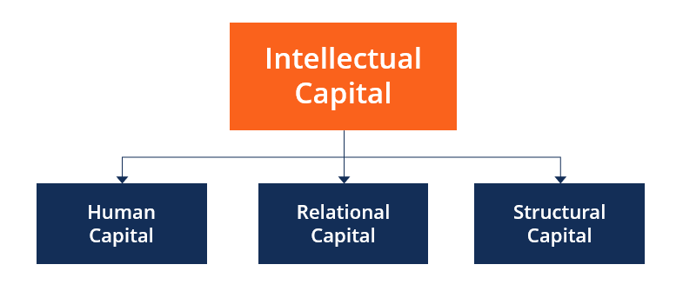
Intellectual Capital: Overview
Intellectual capital is the specific knowledge, skills, relationships, and organizational systems that help a company succeed and differentiate in the market.
The main goal of intellectual capital management is to help companies create more value by making things better or more useful to customers.
This requires companies to assess their resources, improve them, and measure how well they create value—all steps that help the organization grow and succeed.
Notes:
"Now, let's shift our focus to the second major concept of our review: Intellectual Capital.
So what is it? Simply put, it's the collection of nonphysical assets—the knowledge, skills, relationships, and systems—that a company uses to create value and differentiate itself from the competition.
The ultimate goal of managing this capital is to create more value for customers, whether by improving products or creating new solutions.
This requires a continuous process of assessing, improving, and measuring these vital, yet often invisible, resources."

Slide 7
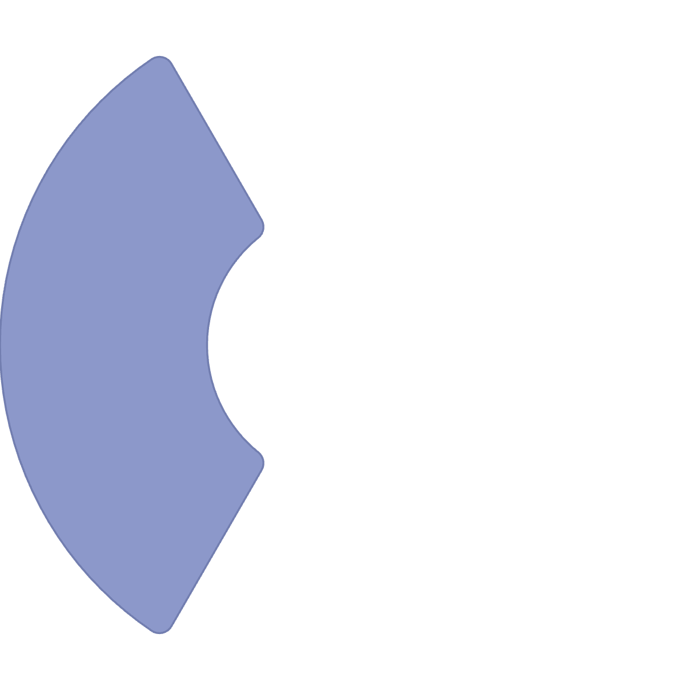





The Three Dimensions of Intellectual Capital
Structural Capital
Systems that support employees
Organizational values and culture
Human Capital
Intellectual property
Knowledge and skills employees possess
Databases and information systems
Processes and methodologies
Problem-solving abilities
Innovation capacity
Relational Capital
Training and expertise
Value from external relationships
Mental and physical well-being
Customer trust and loyalty
Supplier relationships
Brand reputation
Market positioning
Notes:
"Intellectual Capital is generally broken down into three dimensions.
First, we have Human Capital: This is the knowledge and talent of your people.
Second, Structural Capital: These are the systems, processes, and intellectual property that the organization owns.
And third, Relational Capital: This is the value gained by the organization's network of external relationships.
Now Let's look at each one a bit more closely."

Slide 8

Human Capital: The Knowledge Base
Key Characteristics
Human capital refers to the knowledge and skills that employees bring to an organization.
Represents ability to solve problems and support innovation
Includes training, well-being, and approach to tasks
Tied to employee productivity, satisfaction, and loyalty
Belongs to people, not the organization itself
If workforce knowledge becomes outdated without mechanisms for keeping skills current, this asset diminishes in value.
Notes:
"Human Capital it refers to the knowledge, skills, and problem-solving abilities of the employees.
It includes everything from training to the creativity employees bring to their tasks each day.
But here is the critical point: human capital belongs to the people, not the organization. If an organization doesn't have mechanisms to capture this knowledge and keep its workforce's skills current, this vital asset can diminish over time."

Slide 9
Structural & Relational Capital
Structural Capital
Relational/Customer Capital
Non-physical assets and systems that help an organization work efficiently:
Value derived from relationships with external stakeholders:
Company values, culture, and methods
Trust and loyalty built through connections
Intellectual property (patents, trademarks)
Market image and reputation
Databases, software, information systems
Customer licenses and brand names
Leadership structures
Partnerships and alliances
Unlike human capital, structural capital remains with the organization when employees leave.
Critical for internal operations and market competitiveness.
Notes:
"This brings us to Structural Capital. Unlike human capital, this is the knowledge that stays behind.
It's embedded in the organization's systems, culture and unique processes. This is what allows an organization to function efficiently and consistently, even when employees leave.
Finally, we have Relational or Customer Capital. This is the value an organization derives from its external relationships and trust it has built with customers, the strong partnerships with suppliers, and its overall brand reputation in the market. This capital is critical for long-term competitiveness."

Slide 10






Parallels Between Drucker's Theory and Intellectual Capital
Environment
Relational Capital
Understanding market, customers, and technology
Relationships with customers and external stakeholders
Mission
Structural Capital
Organizational goals, culture, and purpose
Systems, processes, and organizational knowledge
Core Competencies
Human Capital
What the organization does best
Skills, knowledge, and workforce capabilities
Notes:
"So, how do these two frameworks—Drucker's theory and Intellectual Capital—connect? As this slide illustrates, there are direct and powerful parallels.
Drucker’s concept of the Environment aligns perfectly with Relational Capital. An organization understands and navigates its market through its relationships with customers and stakeholders.
Drucker's Mission is matching with Structural Capital, the systems and processes it creates.
And Drucker’s Core Competencies are a direct result of its Human Capital—the unique skills and capabilities of its workforce. "

Slide 11
Similarities and Differences
Similarities
Differences
Both focus on non-physical assets driving success
Drucker focuses on foundational principles; IC on measurement and optimization
Both emphasize consistent evaluation and adaptation
Drucker offers philosophical approach; IC uses specific measurement tools
Both aim to create value beyond financial metrics
Both recognize the importance of alignment with external environment
Drucker emphasizes long-term survival; IC balances short and long-term perspectives
Organizations can combine these frameworks to align strategic assumptions with optimization of intangible assets, as Microsoft does with its structural capital while reassessing its mission.
Notes:
"While they align beautifully, the two frameworks also have different focal points.
In terms of similarities, both focus on non-physical assets, both emphasize the need for continuous evaluation, and both aim to create value that goes beyond simple financial metrics.
The key differences lie in their approach. Drucker’s theory is more philosophical, focusing on the foundational principles that guide strategy.
Intellectual Capital, on the other hand, is more measurement-oriented, providing tools to optimize these intangible assets."

Slide 12
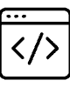


Practical Applications: Case Studies
Microsoft
McKinsey
Nike
In 1995, for every $1 of recorded value, the market saw $9 in additional value not on Microsoft's balance sheet—demonstrating the power of intellectual capital.
Sells analytical knowledge in teams led by senior partners, with clients willing to pay an average of $500,000 per consultant annually for this intellectual capital.
A shoemaker that makes no shoes—focusing on R&D, design, and marketing—with $334,000 in sales per employee through knowledge-based activities.
Notes:
"Let's look at some real-world examples that bring this to life.
Microsoft In 1995, for every $1 of recorded value, the market saw $9 in additional value not on it's balance sheet—demonstrating the power of intellectual capital.
Or consider a consulting firm like McKinsey. Their entire business model is selling human capital. Clients pay enormous sums for the analytical knowledge and expertise of their consultants.
And then there's Nike. Nike's value isn't in factories; it's in its knowledge-based activities: R&D, design, and marketing—all powerful forms of intellectual capital."

Slide 13

Strategic Adaptation: IBM, Merck, and Sony
IBM's Challenge
Successful Adaptations
Failed to reassess outdated assumptions about its environment and mission:
Merck: CEO shifted from exclusive focus on patented drugs to acquiring a major distributor of generic and over-the-counter medications—without waiting for crisis.
Attempted to combine mainframes (memory-focused) with PCs (software-focused)
Assumed "a computer is just a computer"
Sony: Redefined itself from hardware manufacturer seeking software to software producer creating demand for its devices by acquiring a Hollywood movie production company.
Ignored fundamental differences in operation and value
Resulted in strategic "paralysis"
Notes:
"These examples highlight the importance of strategic adaptation.
IBM faced a crisis because its core assumptions became outdated. It tried to manage its new PC business with the same logic as its old mainframe business, assuming that "a computer is just a computer." This failure to adapt its thinking led to a strategic paralysis.
In contrast, look at Merck and Sony. The CEO of Merck proactively shifted the company's strategy by acquiring a distributor of generic medication, even when the company was at its peak.
Similarly, Sony redefined itself from a hardware maker to a software and content company by acquiring a Hollywood studio, creating new demand for its devices."

Slide 14
Related Concepts: Knowledge Management & Social Capital
Knowledge Management
Social Capital
Organizing knowledge to encourage new ideas and improve efficiency:
Value of relationships and networks in enhancing performance:
Intersects with intellectual capital by addressing creation, storage, and application of knowledge
Relates to relational capital by emphasizing trust and collaboration
Ensures human and structural capital are used effectively
Includes business capital (relationships with key stakeholders)
Supports continuous learning and long-term benefits
Contributes to reputation and resource acquisition
Both concepts complement intellectual capital by emphasizing different aspects of intangible assets that drive organizational success.
Notes:
"Finally, it's worth noting that our discussion is closely related to other concepts.
Knowledge Management provides tools and processes to ensure that human and structural capital are used effectively, supporting continuous learning.
And Social Capital, which is the value of relationships and networks, which aligns with Relational Capital, emphasizing the importance of trust and collaboration for success.
These concepts all highlight the growing importance of intangible assets."

Slide 15
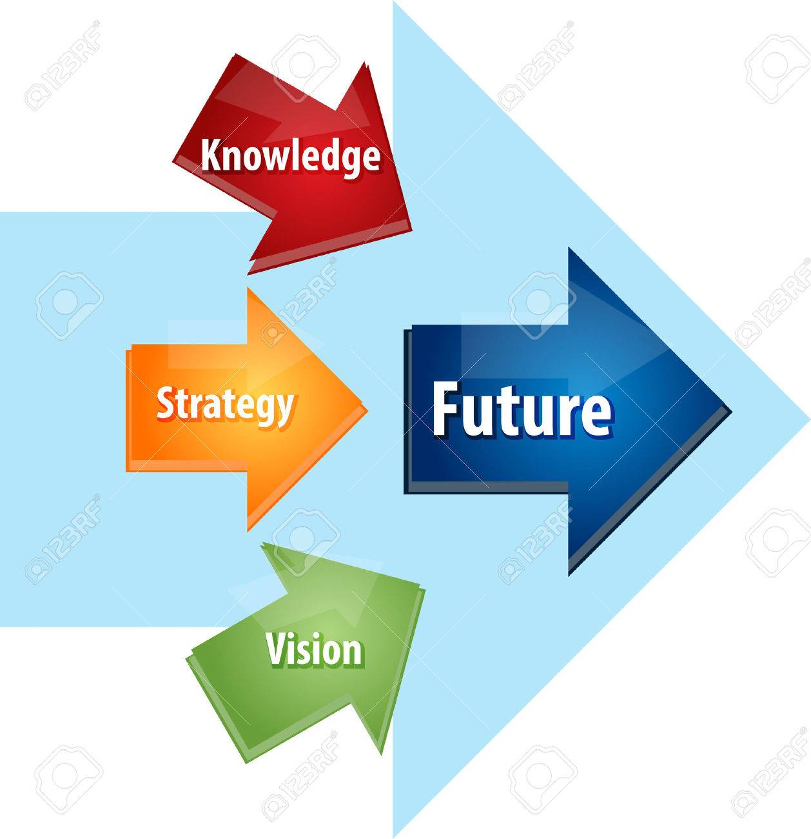
Conclusions and Implications
Drucker's "Theory of Business" and intellectual capital both emphasize the importance of adaptation and innovation in evolving markets:
Combining these frameworks helps organizations become more resilient and competitive
Regular review of assumptions and intellectual assets is essential for
relevance
Transparency in reporting intellectual capital correlates with improved
performance
Future research should develop practical measurement tools linking business assumptions and intangible assets
Merging Drucker's theory with intellectual capital management provides a foundation for sustainable growth, innovation, and stakeholder alignment in our complex global economy.
Notes:
"So, to conclude, what are the key takeaways?
Both Drucker's "Theory of the Business" and intellectual capital stress the same fundamental need: constant adaptation and innovation.
By combining both of these frameworks, organizations can become more innovative, and more competitive. Regular review of both assumptions and intangible assets is absolutely essential to stay relevant.
Ultimately, they provide a solid foundation for sustainable growth in our complex global economy."

Slide 16
Thank you for your attention!!!
Any Questions?
Notes:
"That brings me to the end of my presentation. Thank you very much for your time and attention. I would now be happy to answer any questions you may have."

